Slide 1
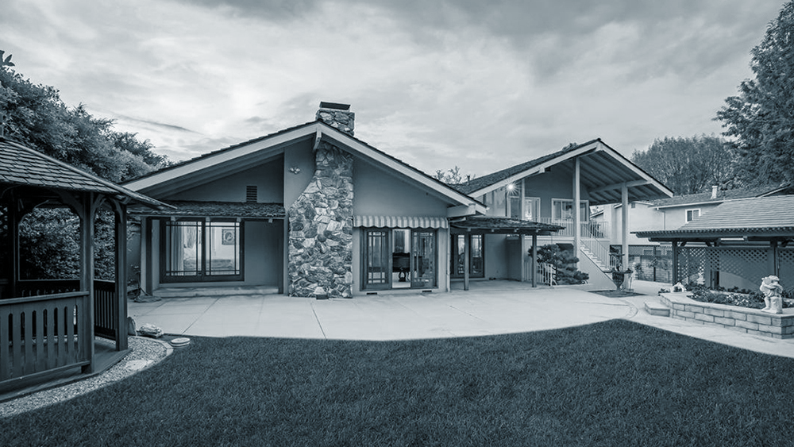

Ames Housing
Modeling and Analysis

Slide 2
Problem statement
Determine the best model for predicting Sale Price for houses in Ames (R² of at least 0.81, and should generalize well to new data within the Ames area)
Use the model to answer the following:
What features add the most value to a house, and which hurt house values most?
With a set of features, what is the expected sale price of a house?
Given a budget, what kind of house would one be able to afford?

Slide 3
Workflow
Cleaning
&
Preprocessing
Modelling & Evaluation
Feature
Selection
EDA

Slide 4
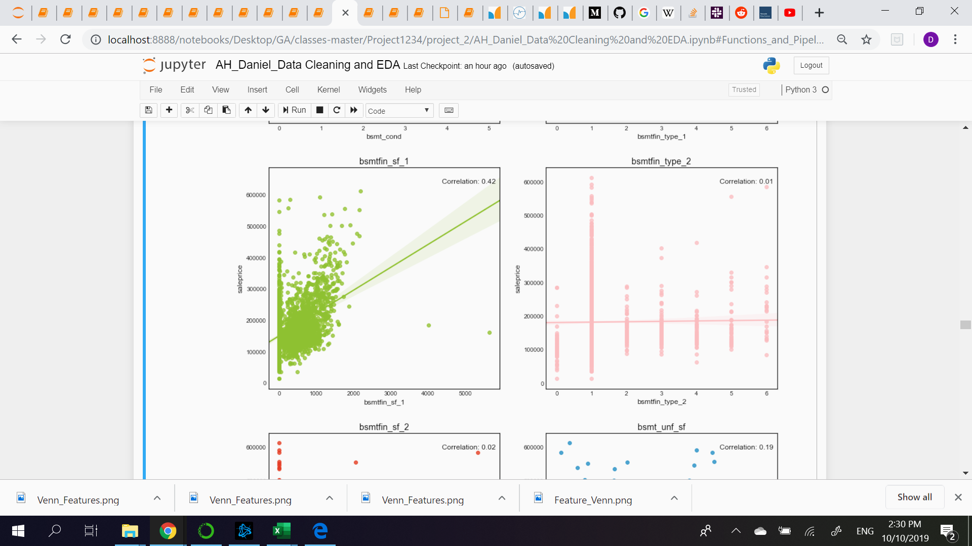
Data Cleanliness and Encoding
Eliminate Outliers.
Outliers
“Missingness”
Dummying
Replace with 0 / “NA” if NaN.
Simple / Iterative Imputation if truly missing.
Categorical variables were one-hot encoded.
Variables like “Bsmt Qual” were transformed as Likert scales.

Slide 5
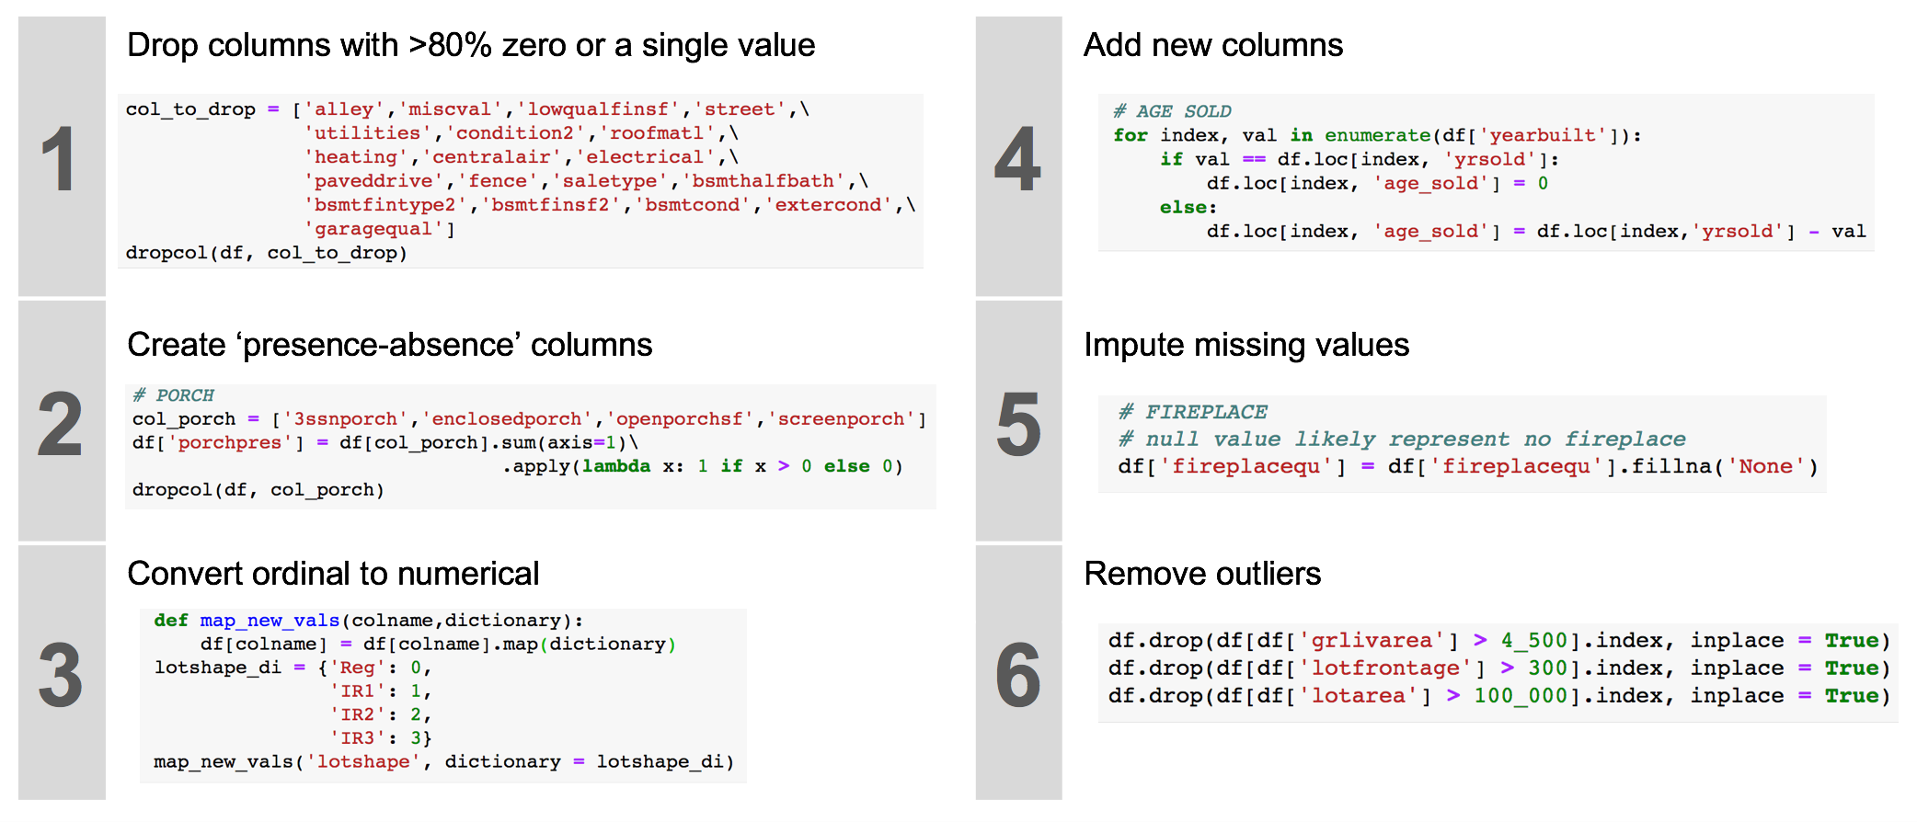
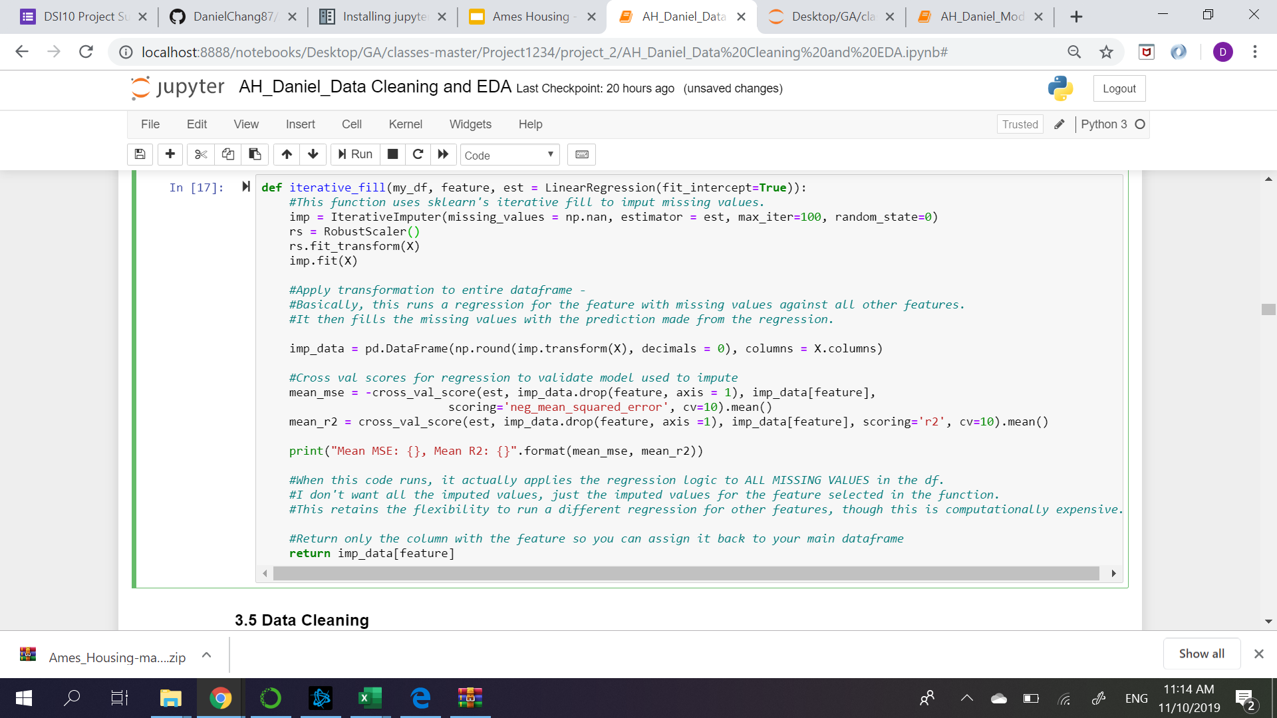
Code Snippets

Slide 6
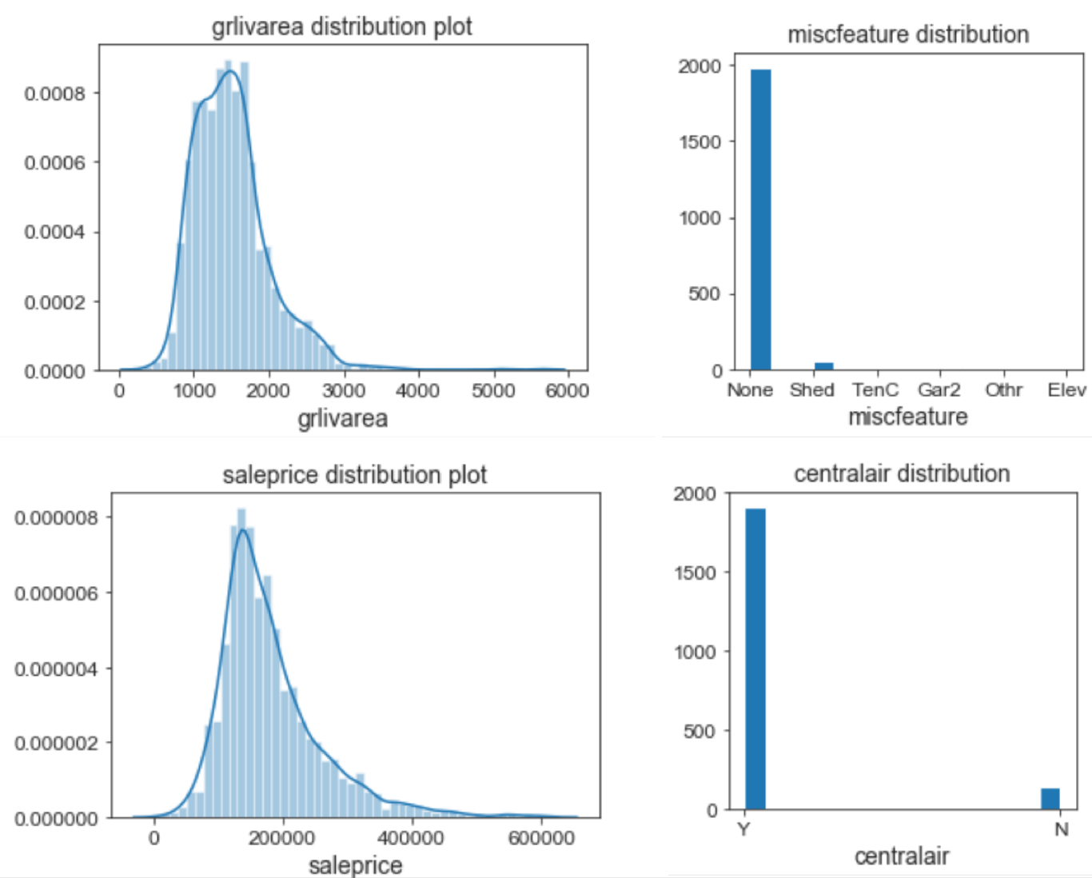
Heavily skewed
columns

Slide 7
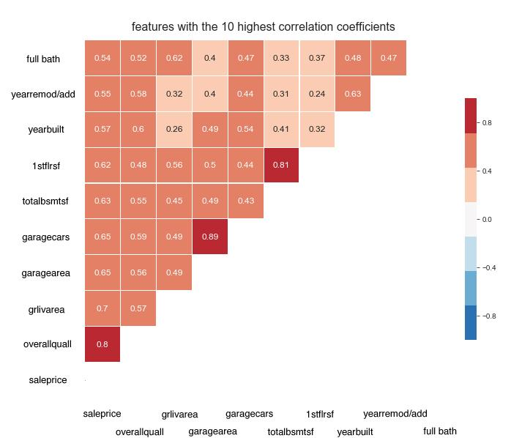
Multicollinearity

Slide 8
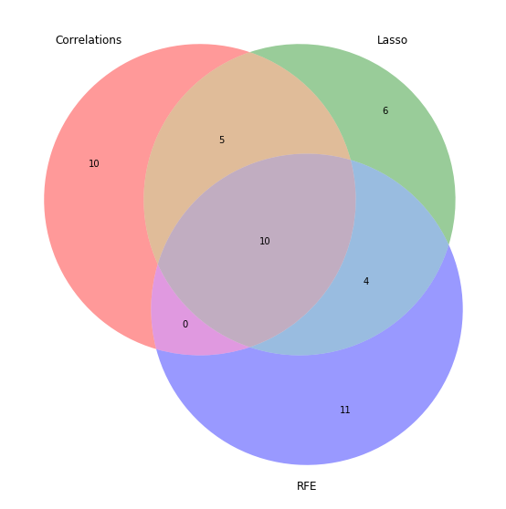
Feature Selection
Overlap of Feature Selection Methods
Three feature selection methods were used:
Filter (by correlation)
Wrapper (Recursive Feature Elimination)
Embedded (Lasso)
The features from all three methodologies were compared, and returned a list of 10 features that were shared.

Slide 9
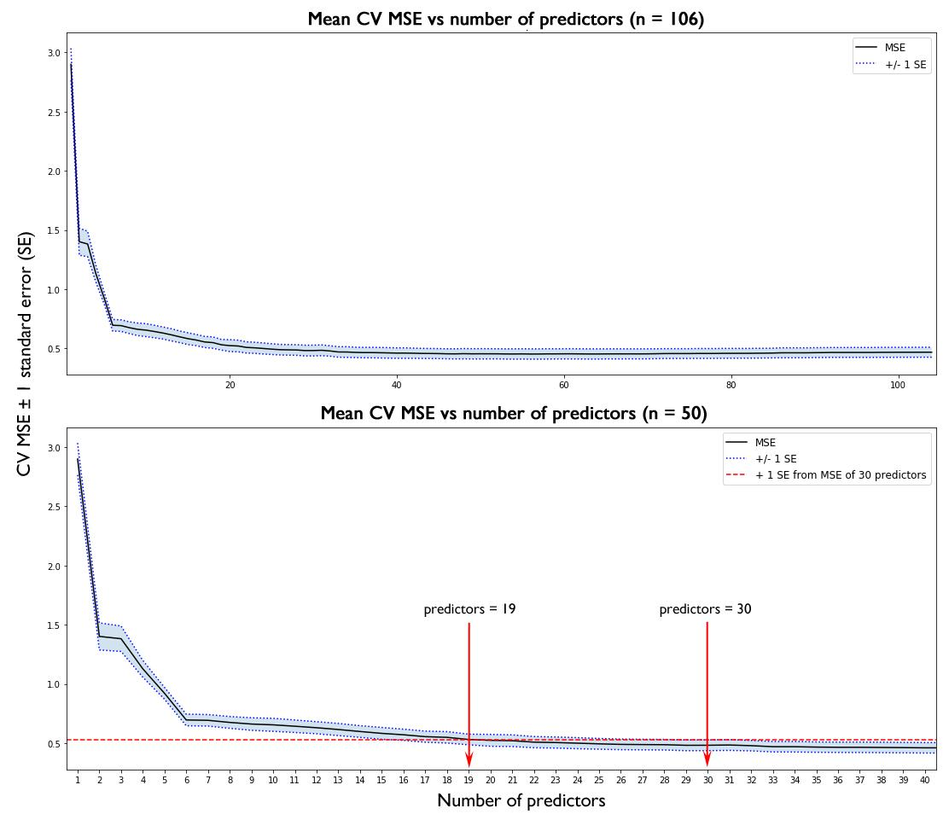
Forward Selection
Feature Selection
CV MSE +/- 1 Standard Error

Slide 10
Comparing Model R2
Feature Selection Method
 | Filter | Embedded | Wrapper | Combined | Forward Selection
Linear |  | - | - | - | 0.81
Ridge | 0.87 | 0.89 | 0.89 | 0.86 | 0.918
Lasso | 0.87 | 0.90 | 0.89 | 0.86 | 0.918
Enet | 0.87 | 0.90 | 0.89 | 0.86 | 0.919
Poly Enet | - | 0.93 | - | 0.90 | -
Regularization Models

Slide 11
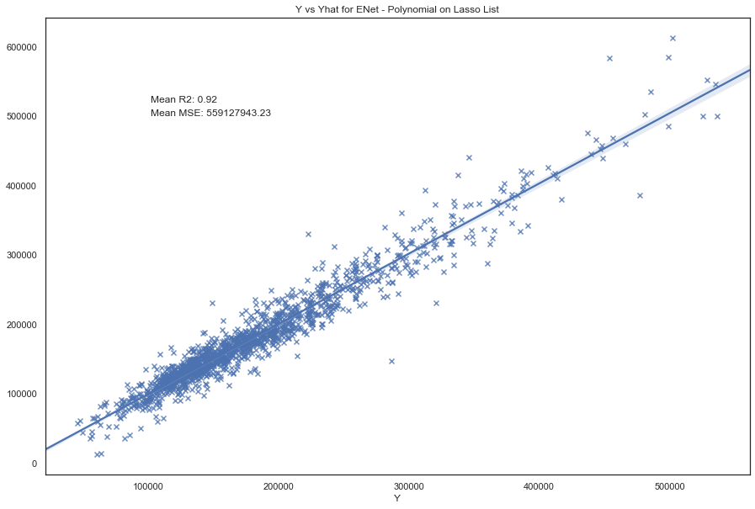
Model Performance
Y true
Polynomial elastic net
R² = 0.93
Y predicted

Slide 12
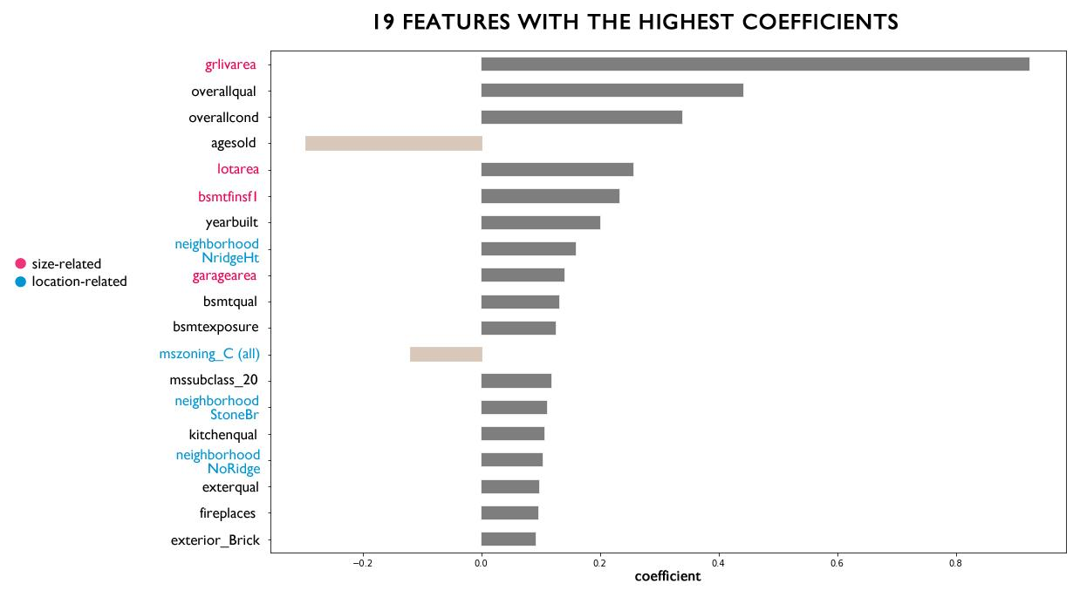

Slide 13
Summary of Findings
The ElasticNet model was the best performing in terms of both R² and MSE.
Square feet area, condition, age, and the location of the house are the most important determinant factors of sale price
House buyers should invest in Northridge Heights, Stone Brook, and Northridge
People looking to sell should do it sooner rather than later
To increase the value of a home:
Repaint/remodel the interior and exterior finish
Renovate the kitchen
Add a fireplace (if not already present)
Renovate the garage if it is in bad condition
Renovate the house if it had been severely damaged

Slide 14
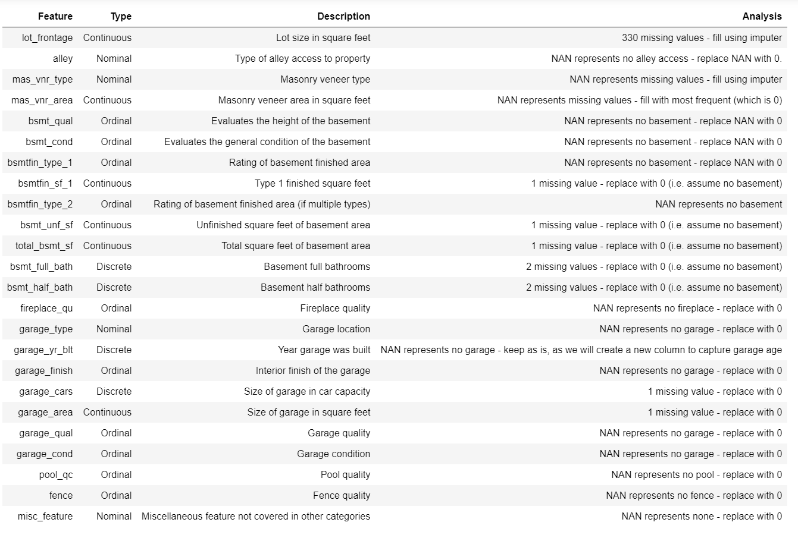
Data Dictionary

